Slide 1







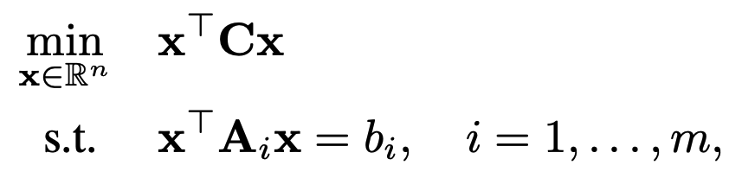
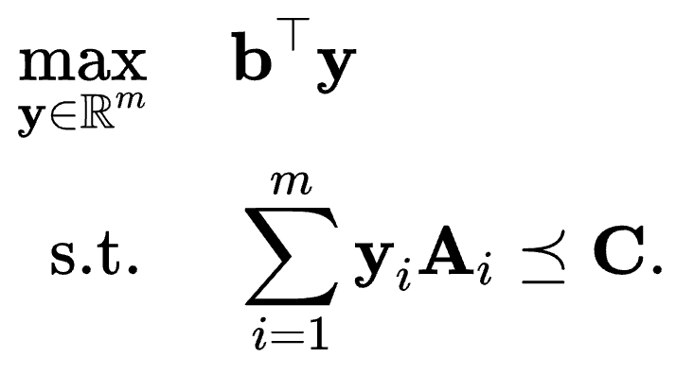
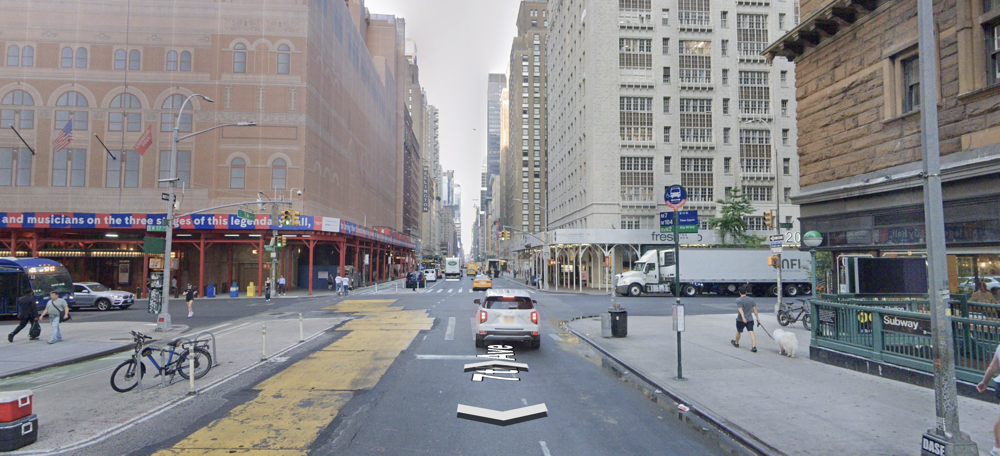
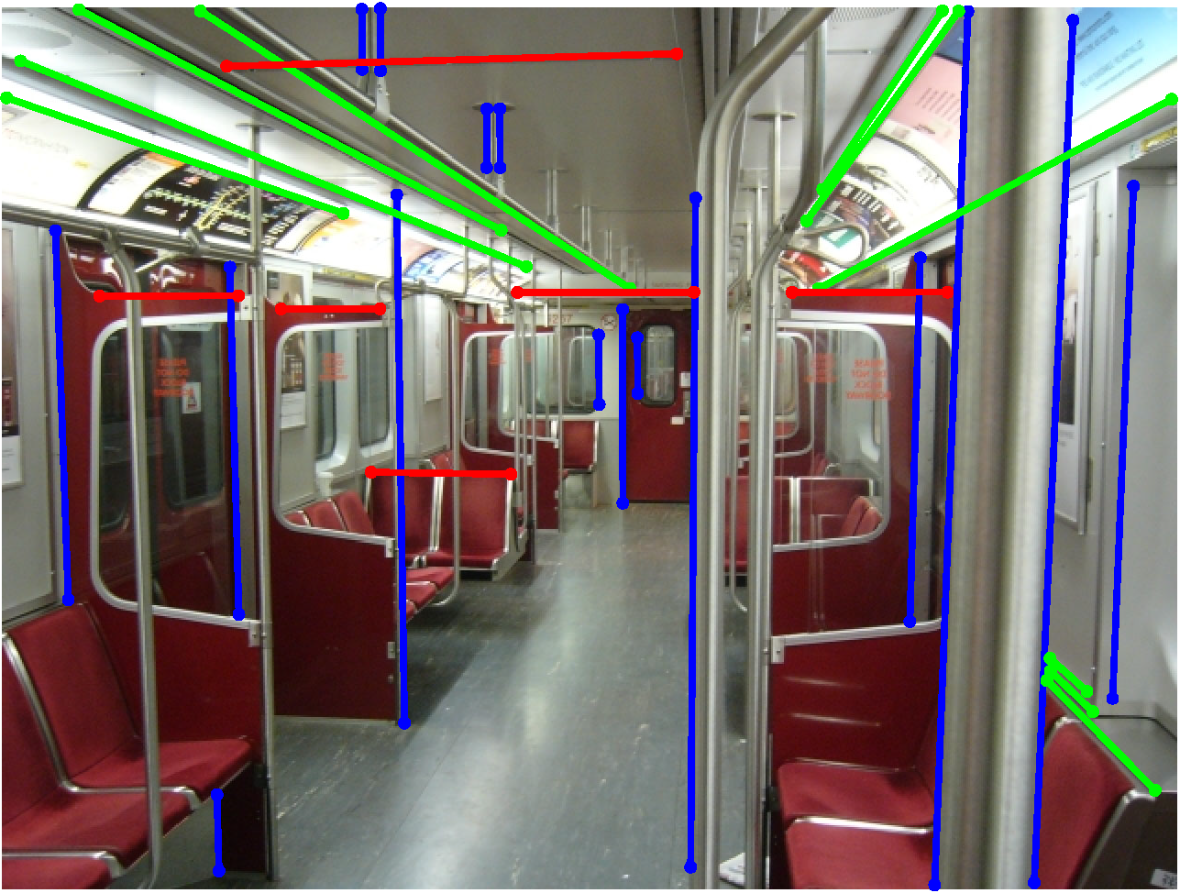
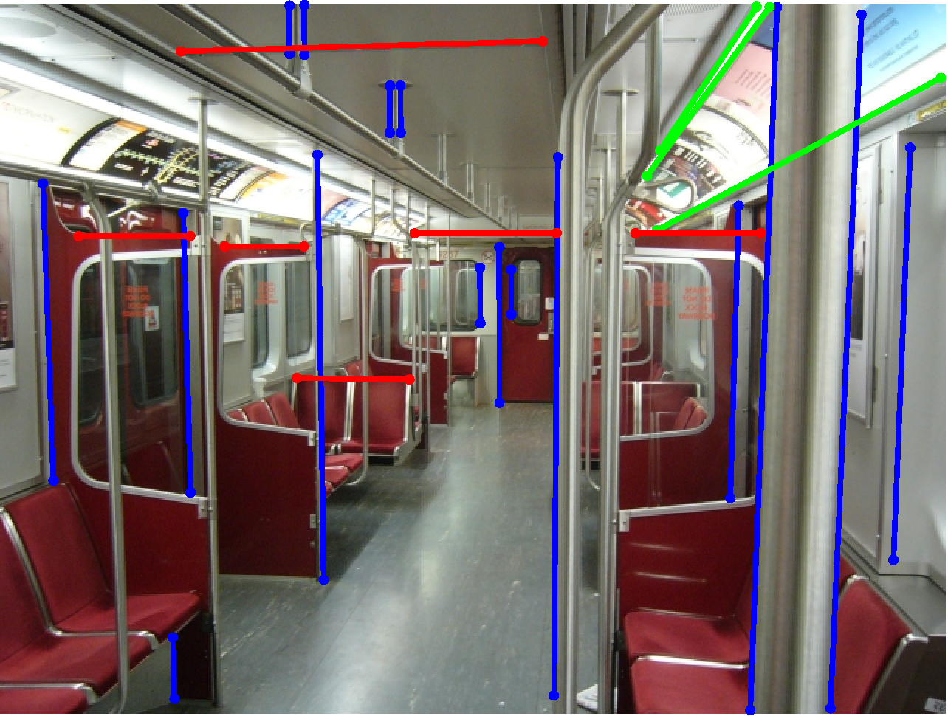
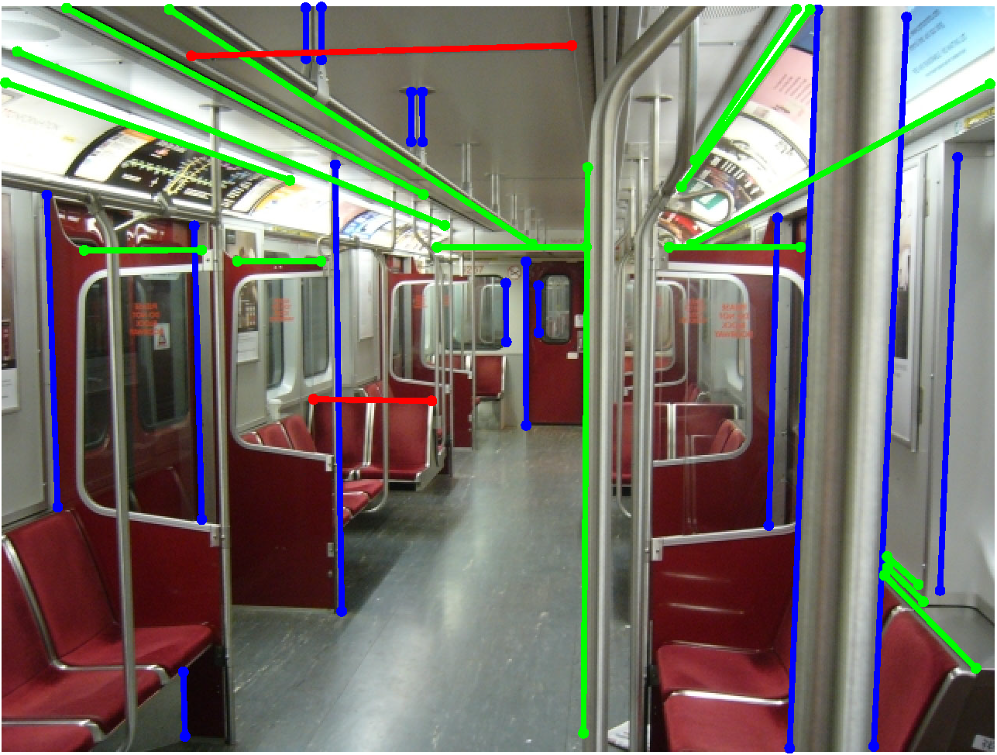
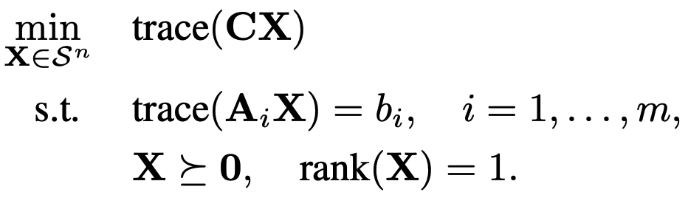
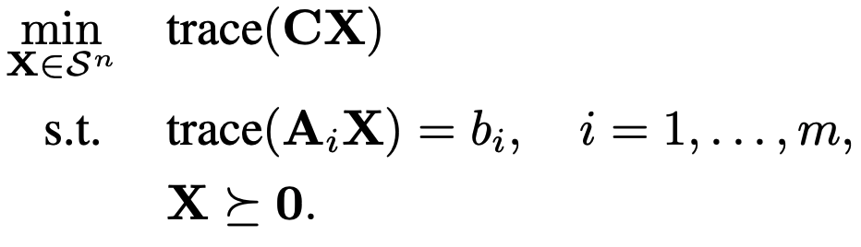
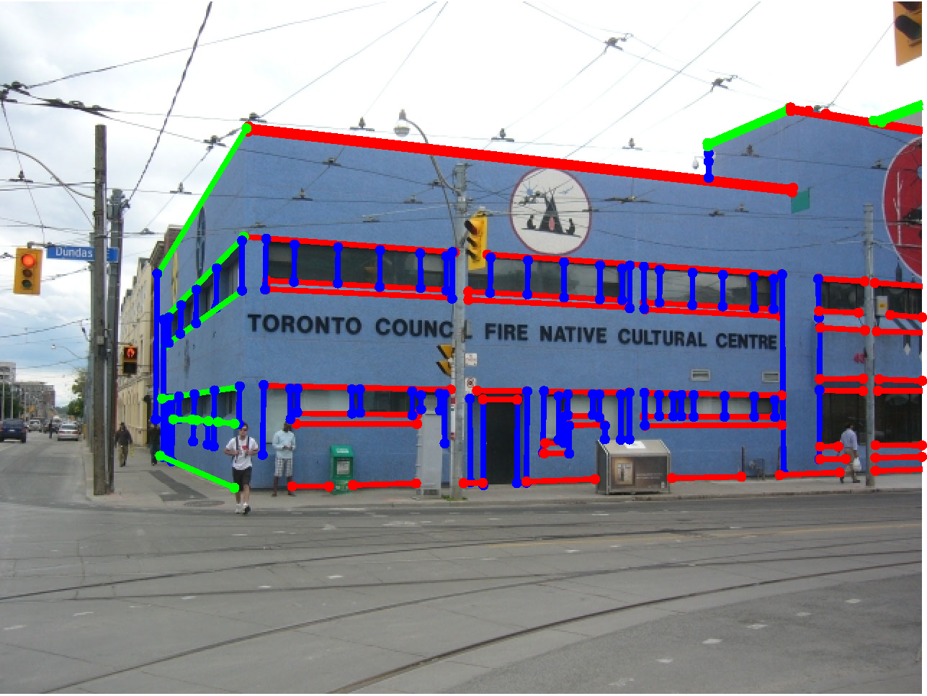
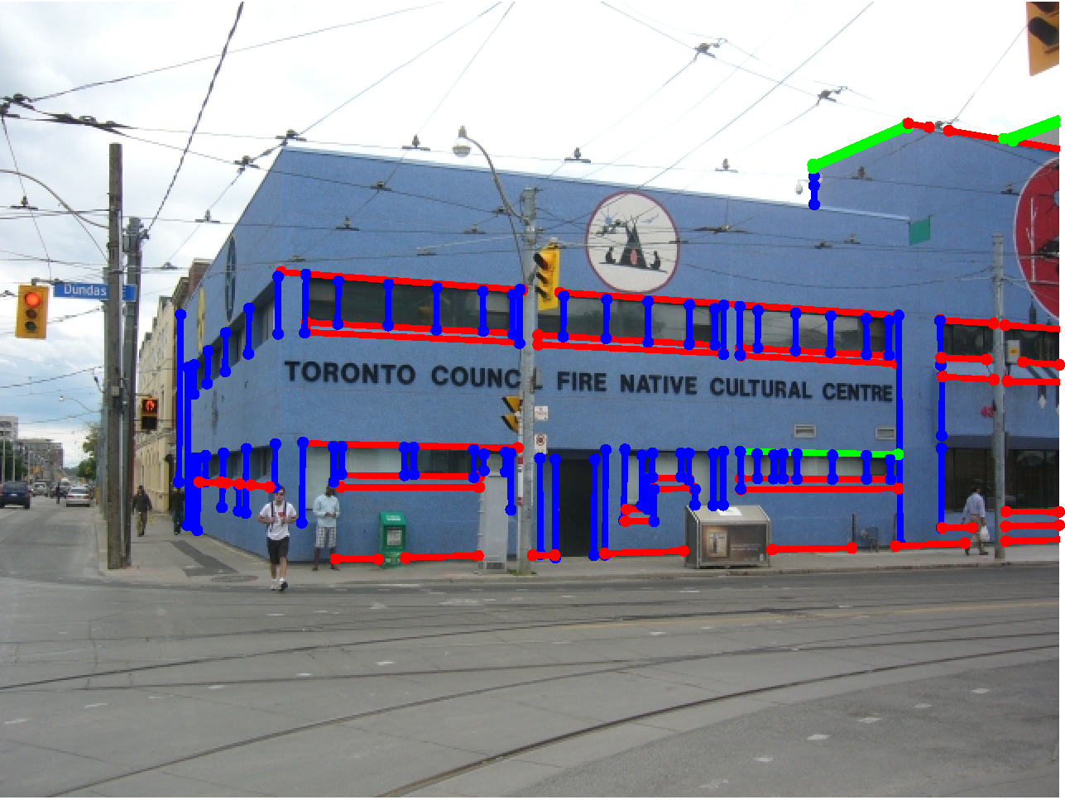
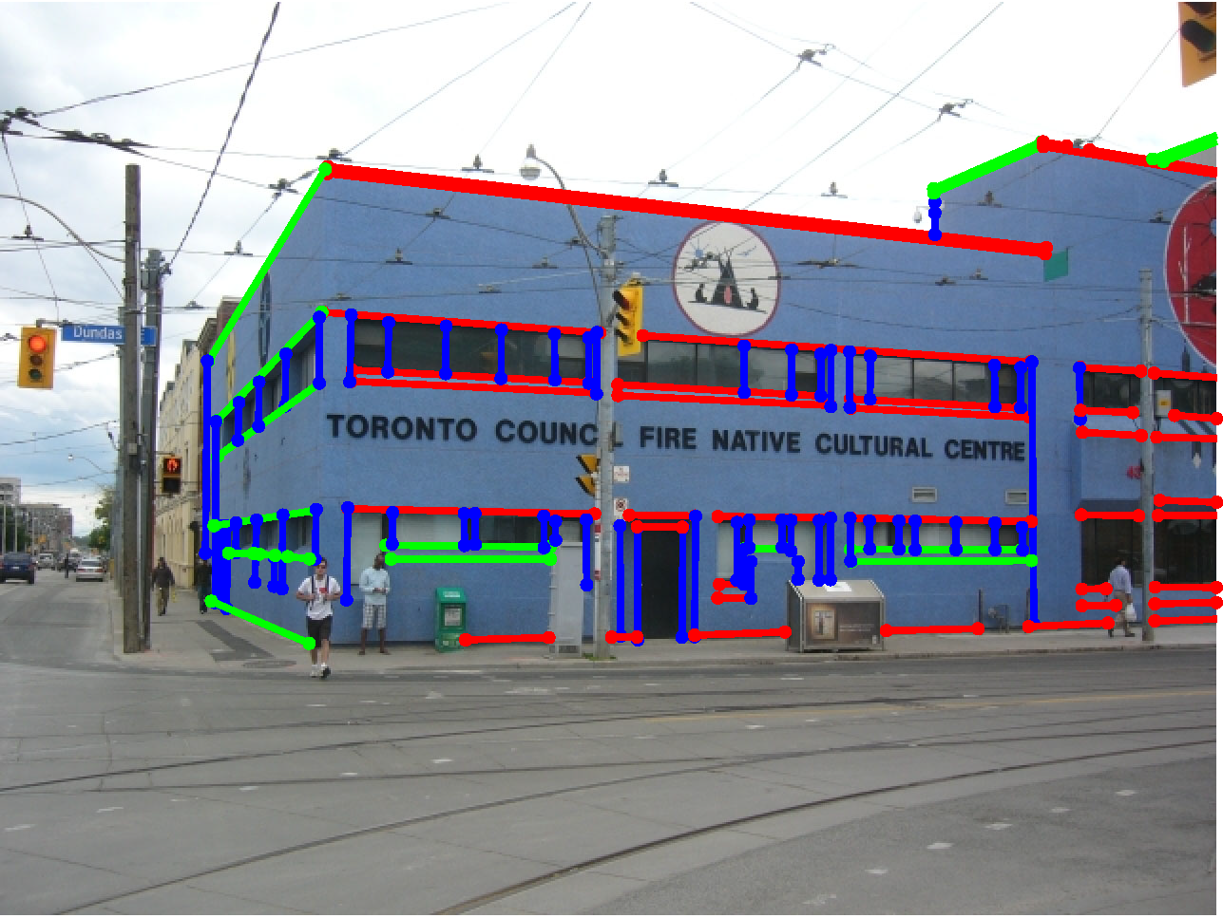
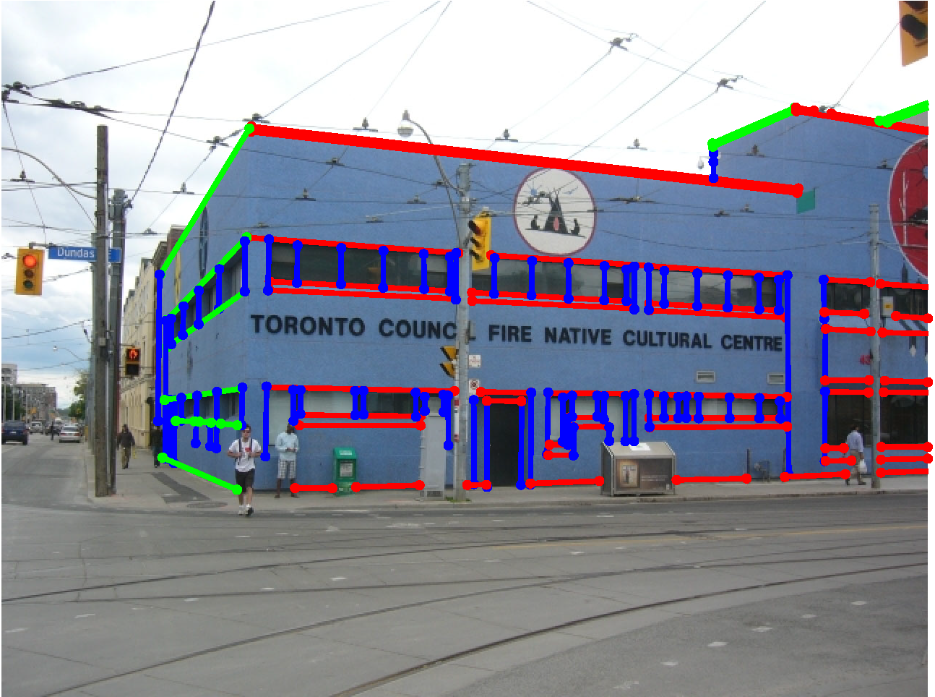
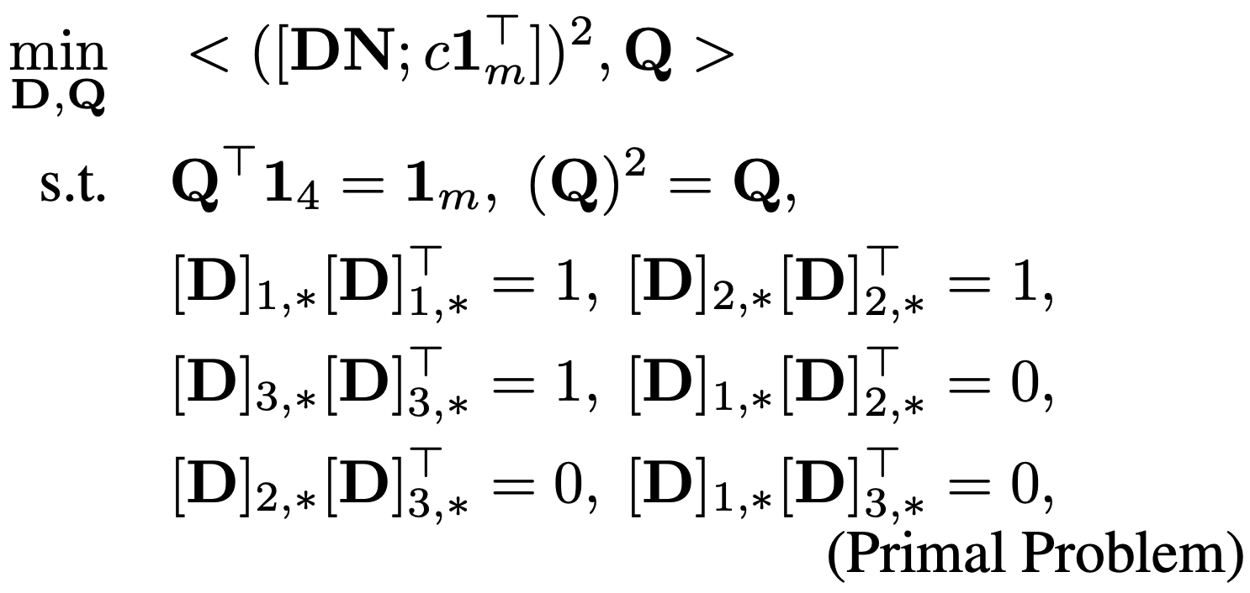
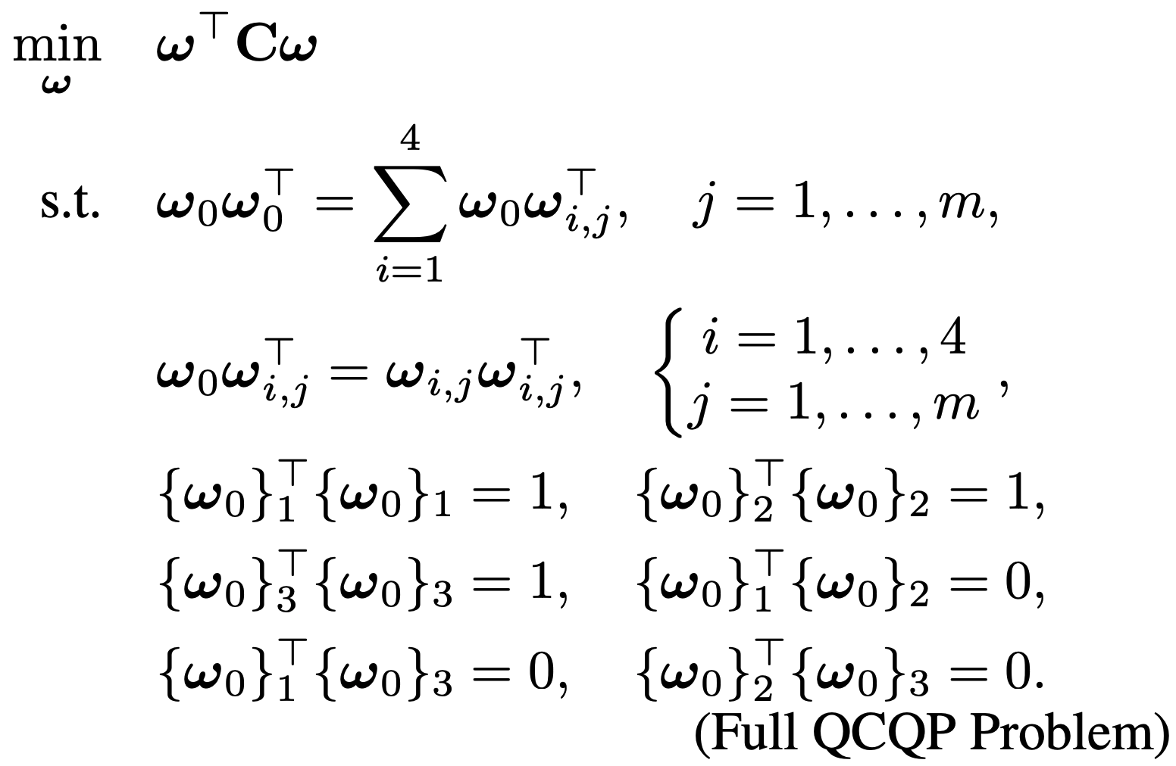
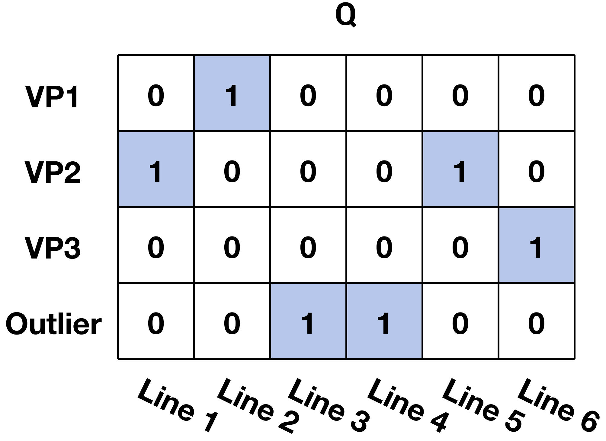
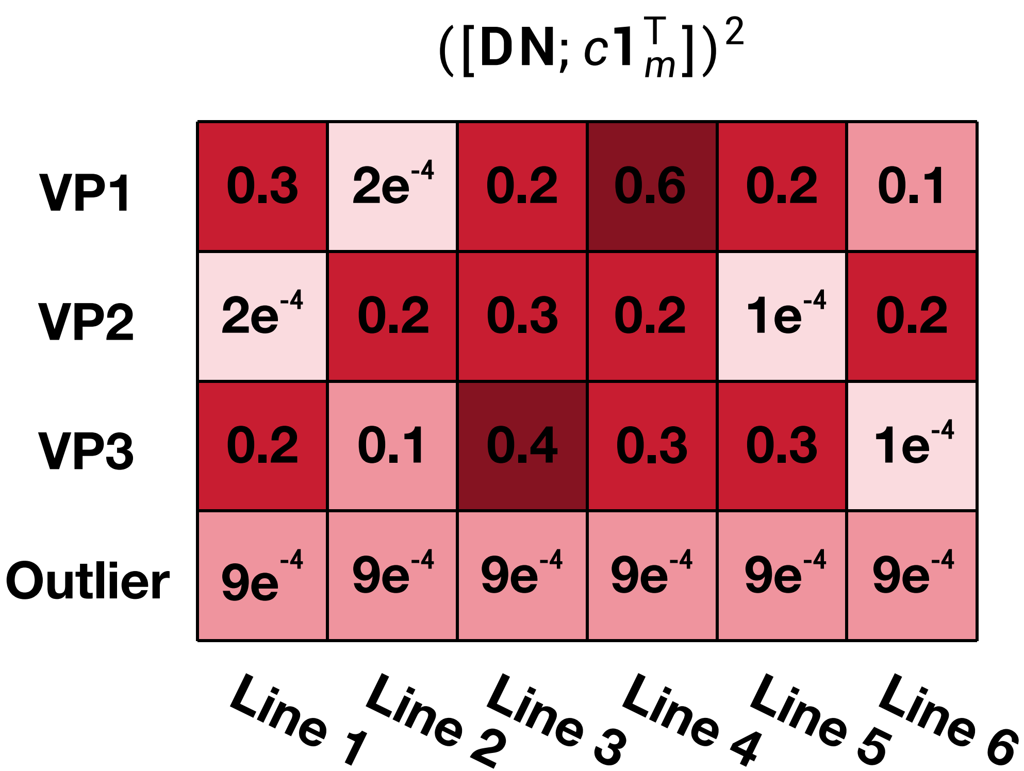
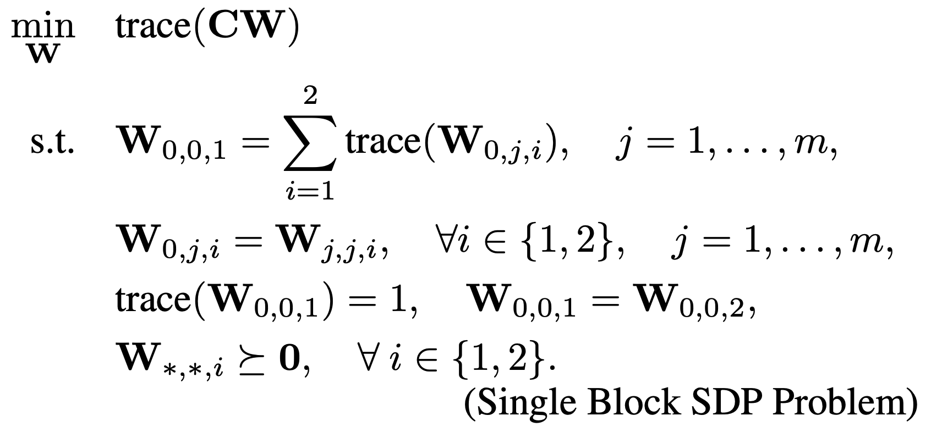
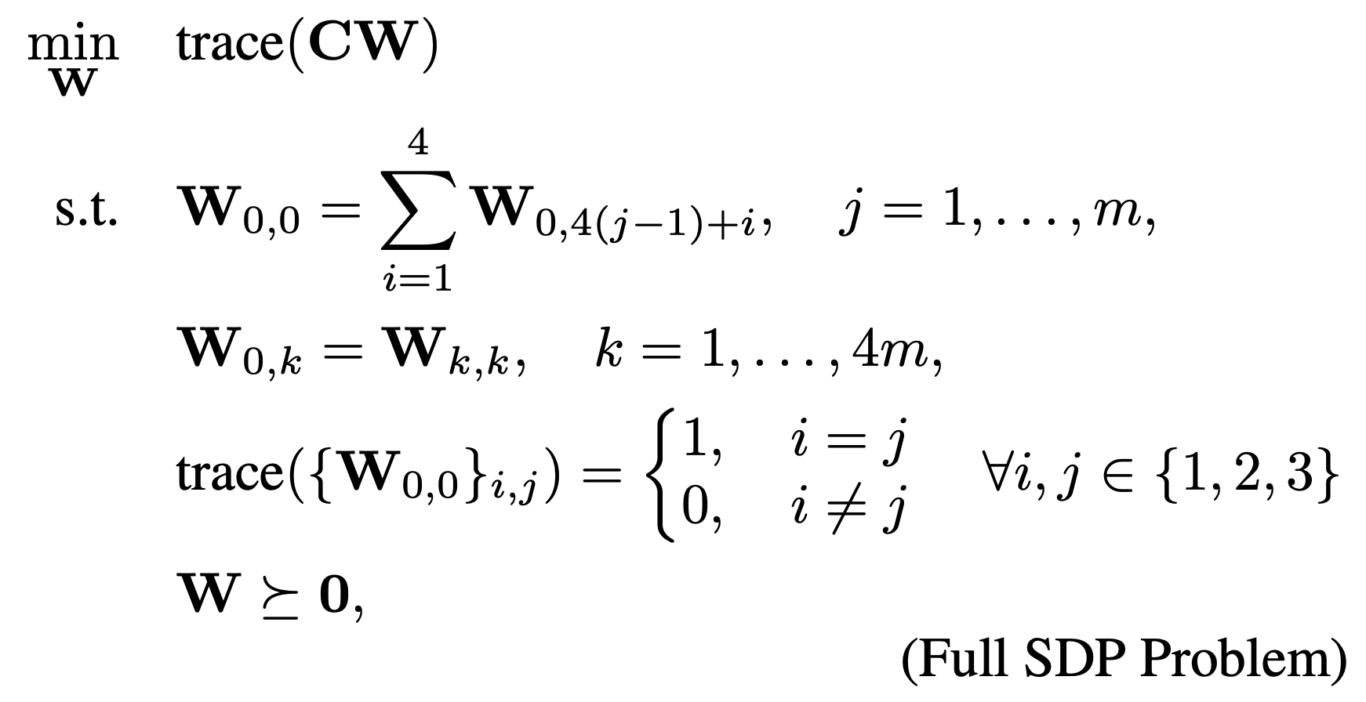
GlobustVP: Convex Relaxation for Robust Vanishing Point Estimation in Manhattan World Bangyan Liao^{1,2*}, Zhenjun Zhao^{3*}, Haoang Li⁴, Yi Zhou⁵, Yingping Zeng⁵, Hao Li¹, Peidong Liu¹
Introduction
Convex Relaxation
Task
SDP Dual
Experiment
VP2
QCQP
Lagrangian Duality
Non-convex QCQP
F1-score↑
Consistency error↓
85.71%, 1.01 pix.
64.29%, 2.19 pix.
100%, 0.41 pix.
VP3
VP1
Convex Relaxation
Equivalent
Lagrangian
Duality
Convex SDP Dual Dual
SDP Dual Dual
Convex SDP Dual
Input:
Unlabeled Lines
Output:
Labeled Lines
Rank
Relaxation
Ground Truth
RANSAC
BnB
Ours
Vanishing Points VP1 VP2 VP3
Motivation
Efficiency
90.08%, 0.45 pix.
High Efficiency
Ransac
Ours
GlobustVP
Methods
F1-score↑
Consistency error↓
87.60%, 0.52 pix.
100%, 0.01 pix.
EM
F1 Score with 30% outlier
F1 Score with 70% outlier
Time (s) with 20% outlier
Learning-based
Primal Problem
QCQP Problem
100%
100%
10⁴
Low Efficiency
BnB
75%
75%
Optimality
From QCQO to SDP
50%
50%
Local Optimality
Global Optimality
25%
25%
10⁻¹
Robustness
0
10⁻²
Outlier non-Robust
Outlier Robust
0
0
Contribution
BnB
RANSAC
Ours
Convex
Relaxation
• A “soft” association scheme, realized via the proposed truncated multi-selection error, for joint estimation of VPs’ location and line-VP association.
• Introducing convex relaxation to reformulate the intermediate QCQP form of the primal problem as a convex SDP problem.
• An iterative solver, GlobustVP, that solves each VP subproblem independently (corresponding to a sub-block of the full SDP problem), achieving global optimality under mild conditions.
• Extensive evaluations on both synthetic and real data demonstrate that our method achieves superior accuracy and robustness, while being on par with prior methods in terms of efficiency.
YUD AA@10°
SU3 AA@10°
100%
100%
Iterative SDP Solver: GlobustVP
SDP Problem
75%
75%
Iterative Solver
50%
50%
25%
25%
0
0
NeurVPS
PARSAC
Ours

